Slide 1
Getting Organized
Structure

Slide 2
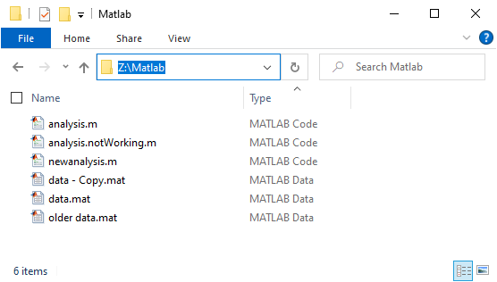
File Chaos
Data and code are mixed
File names are abstract
Different versions of the same code/data are kept

Slide 3
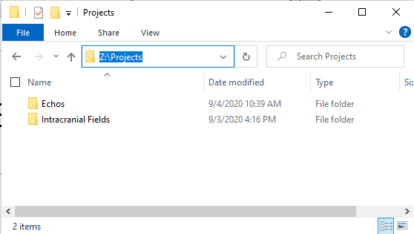
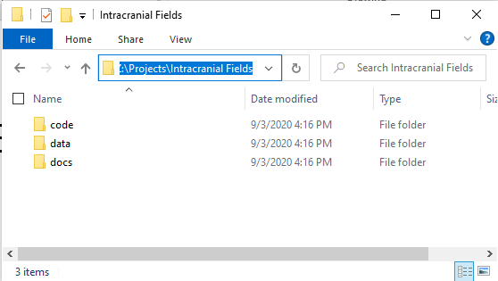
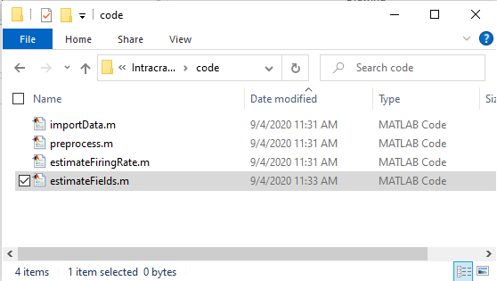
Structured Solutions
Chaos
Structure
Mixed data and code
Abstract file names
Multiple versions
One folder per project
data/code/docs
Use meaningful file names
estimateFiringRate.m
Separate logically/conceptually distinct units
read/preprocess/analyze/visualize
Use git for version control

Slide 4
Folder & File Structure
Easier to
Understand
Share Data, Code, or Docs
Reuse/Update code
Reproduce
The basic structure for this course:
\Module\
\code\
\data\
\docs\

Slide 5
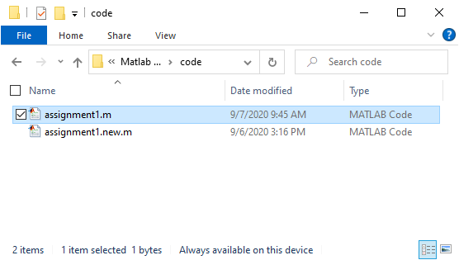
Version Control Software : git
Keeps track of different versions (including the latest one)
Avoids file clutter
Allows you to backtrack
Documents changes: who, when, and why
Simplifies collaboration and code sharing
Simplifies code review

Slide 6
Git Terminology
Repository – the collection of all versions of all files.
Local: the repository on your machine
Remote: the repository on a server somewhere else (github.com)
Stage – Label the changes in a file for inclusion in the Repository
This allows you to keep some files or changes only in the Sandbox, while others are going to be added to the Repo.
Commit – Add all staged changes to the Local Repo
This is where you add a message explaining why these changes were made.
Push – Add changes in the Local Repo to the Remote Repo

Slide 7
Git Terminology
Clone – create a local copy of the central Repo.
Pull – Add changes from the Central Repo to the Local Repo.
Branch – A copy of the code where you develop new features without interfering with the code that has already been developed.
Main branch - tested/released code.
Develop branch - newly developed code.
Pull Request – Submit a branch for review.
In this course, you create assignments and receive feedback from the instructors on the feedback branch.
Merge – include the changes from one branch into another.

Slide 8
Git is not meant for large data files. (< 50 MB)
Use Version Control for Data:
Git Large File Storage (LFS)
< 2 GB
Git Annex
Complicated to setup
Hard to maintain
Datalad
Uses git-annex internally.
Hard to maintain.
Do you really need version control for data?

Slide 9
Git is not meant for large data files. (< 50 MB)
Data streaming service (Google Drive, OneDrive, Box,…)
Setup a structured folder for all your data:
\data\project1
\project2
Stream or Sync project to your workstation
Google Drive:
Offline Access\Make Available Offline
One Drive:
Always keep on this device
Advantages:
Share by providing a read-only link (put instructions for users in the project Readme.md)
Automatically backed up by Google/Microsoft/Box
Save space on your workstation by selective syncing (or streaming)
Coding
Write your code such that the data folder can be changed easily.

